Slide 1
2rd Grade
Computer Science Dept/ College of Education for Pure Sciences
Special Topics: Microprocessor & Assembly Language
lecture2
Instructor: Ghazwan Abdulnabi Al-Ali
University of Basrah, Iraq

Slide 2
Memory Segmentation and Segments Register
Code Segment (CS).
Data Segment (DS).
Stack Segment (SS) .
Extra Segment (ES).

Slide 3
Data Register
  AX 16 bits
  AL,AH 8bit, 8bit
AX
AH, AL
BX
BH,BL
CX
CH,CL
DX
DH,DL

Slide 4
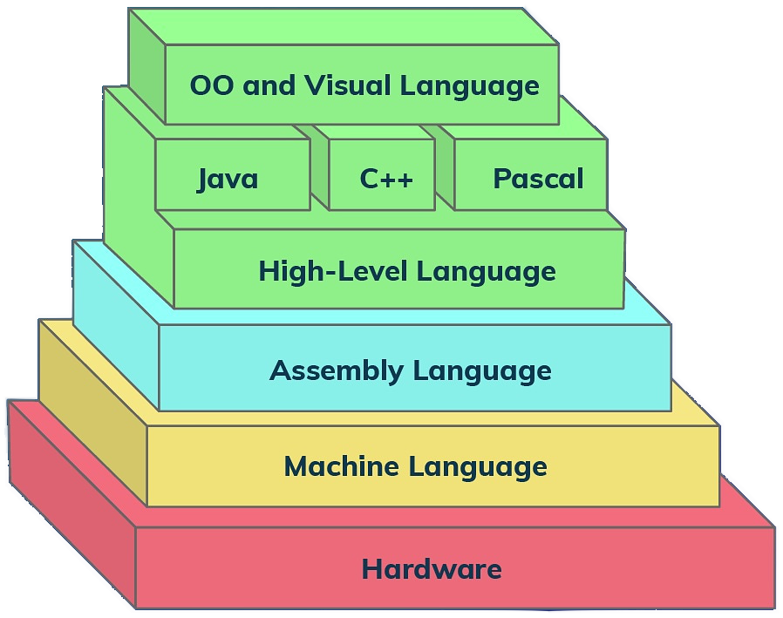
Assembly Language
C++ code | ASM
x=10 y=5 x=x+y | Mov aL,5 Mov bL,4 Add aL,bL

Slide 5
arithmetic operations
add | Add al,bl | X=x+y
sub | sub al,bl | X=x-y
inc | Inc cl | i++ i=i+1

Slide 6
compare
Cmp bh,ch
jmp 100
JE
JG
JEG
JL
JLE

Slide 7
Implementing control structures using in assembly language
if
C++ structures | Assembly structures
If(Condition) Statment1 Else Statment2 | cmp Reg1,Reg2 (je ,jl,jle,jg,jge,…) if1 Statment2 jmp Continue1 if1:Statment1 continue1:

Slide 8
EX: Write a program in assembly language to find the max of two elements
C++ | Assembly
X=5 Y=3 If(x>=y) Max=x Else Max=y | mov al,5 mov bl,3 cmp al,bl jge if1 mov ah,bl jmp cont1 if1:mov ah,al cont1:

Slide 9
For in assembly language
C++ | Assembly
n=5 For( i=0;i <=n ; i++) { Statements } | mov reg1,5 mov cl,0 rep1:Statements inc cl cmp cl,reg1 jle rep1:

Slide 10
EX/ Write a program in assembly language to sum elements from 0-5
C++ | Assembly
n=5 Sum=0 For( i=0;i <=n ; i++) { sum=sum +i } | mov bl,5 mov bh,0 mov cl,0 rep1:add bh,cl inc cl cmp cl,bl jle rep1:

Slide 11
H.W
write an assembly program to find x*y using repeated
addition:

Slide 12
Solution:
Assembly | Assembly
mov cl,0 mov bl,5 mov bh,3 mov ah,0 rep1:add ah,bh inc cl cmp cl,bl jl rep1: | mov cl,5 mov bh,3 mov ah,0 rep1:add ah,bh dec cl cmp cl,0 jg rep1:

Slide 13
H.W
write an assembly program to find x/y using repeated
subtraction :

Slide 14
Thank You

